Slide 1

Payroll Management Frontend
This presentation explores the frontend development of a payroll management system, focusing on technologies like Next.js, Material UI, and integration with a Spring Boot backend.

Slide 2
Employee Salary Structure
Data Display
Material UI
The frontend displays the employee salary structure, which is fetched from the Spring Boot backend. This includes details like base salary, allowances, deductions, and net salary.
Material UI components are used to create a visually appealing and user-friendly interface for displaying the salary structure data.

Slide 3
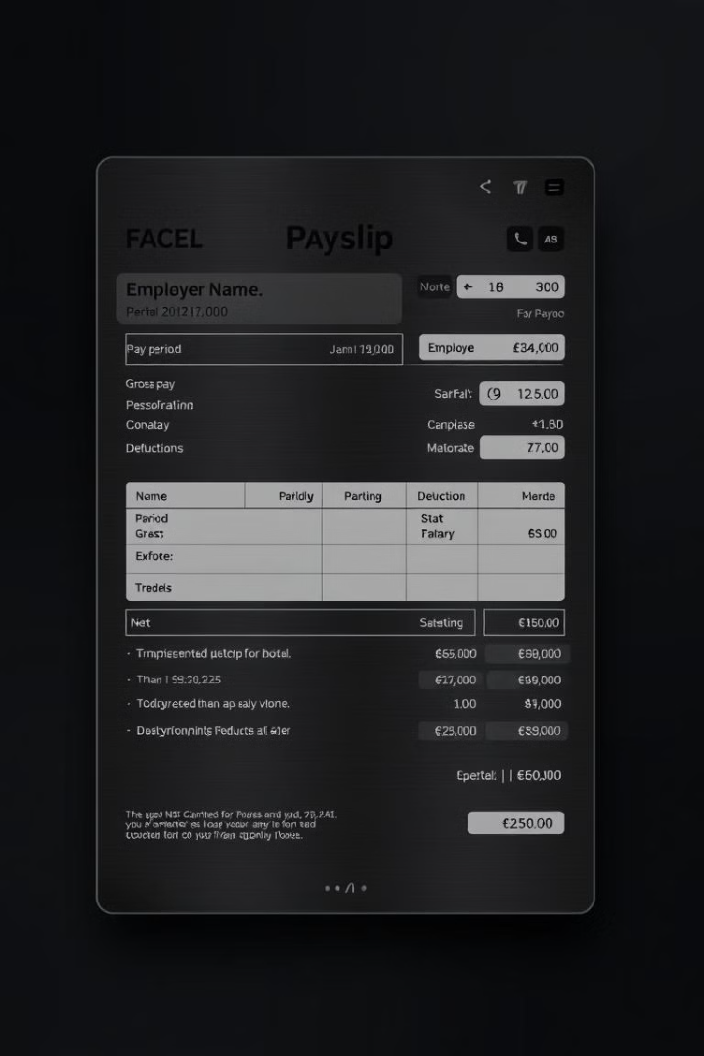
Payslip Generation
1
Bulk Upload
2
Payslip Design
The frontend allows administrators to upload an Excel file containing employee IDs and leave of absence (LOP) data.
The system offers multiple payslip designs to cater to different company preferences.
3
Data Processing
The frontend processes the uploaded data and sends it to the backend to generate payslips for the selected employees.

Slide 4
Next.js for Frontend Development
Server-Side Rendering
Component-Based Architecture
Next.js enables server-side rendering, improving SEO and initial page load times.
Next.js promotes a component-based architecture, making code reusable and maintainable.

Slide 5
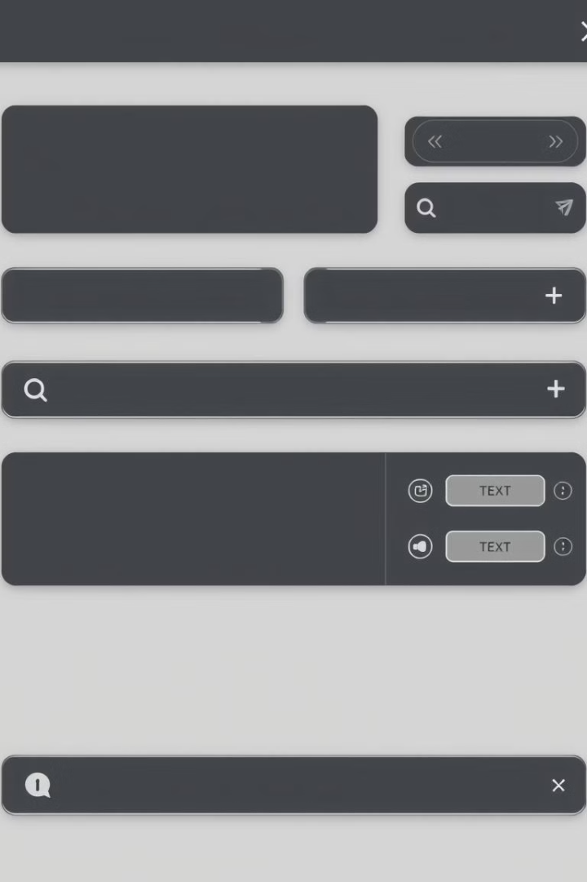
Material UI for User Interface
Pre-Built Components
Customization
Material UI provides a wide range of pre-built components, accelerating development and ensuring consistency.
Material UI components can be easily customized to match the company's branding and design preferences.
Accessibility
Material UI components are designed with accessibility in mind, ensuring a user-friendly experience for all.

Slide 6

Employee Salary Structure
The system calculates employee salaries based on their designated pay rates and working hours.
Hourly Rate
Overtime Calculation
Deductions
Employees are paid based on an hourly rate, which is set according to their job role and experience.
The system automatically deducts taxes, insurance premiums, and other contributions from employees' salaries.
The system calculates overtime pay for hours worked beyond the standard work week, at a predetermined overtime rate.

Slide 7
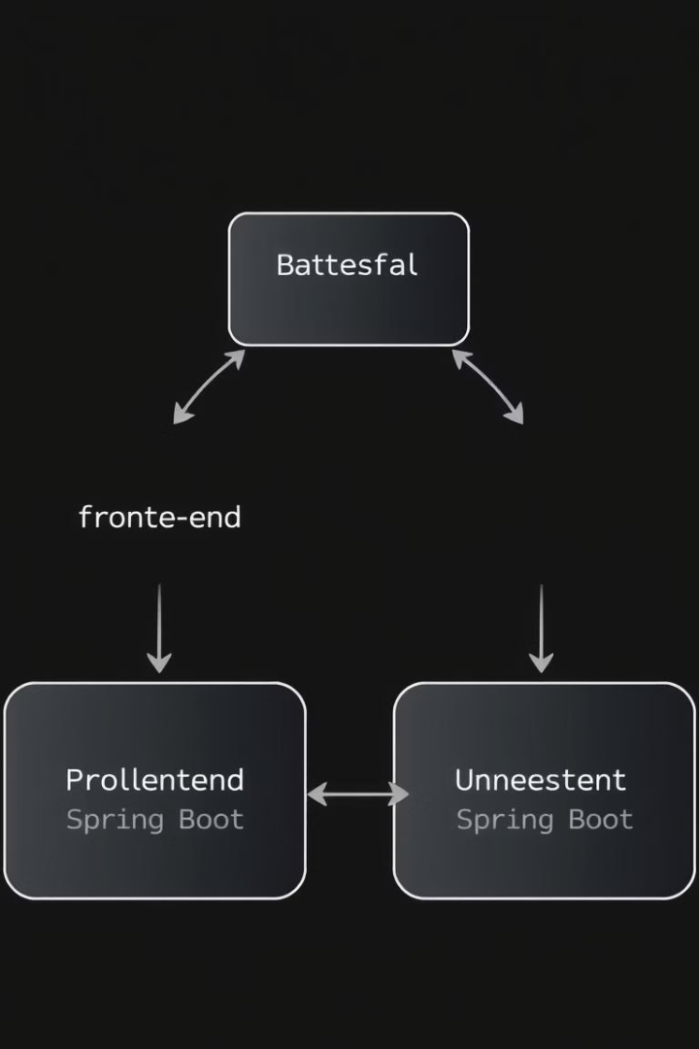


Backend Integration with Spring Boot
Data Storage
API Endpoints
The Spring Boot backend interacts with the PostgreSQL database to store and retrieve employee data, salary information, and payslip details.
Spring Boot exposes RESTful APIs that the frontend uses to fetch data, submit requests, and receive responses.

Slide 8

Payslip Generation
Upon successful salary calculation, the system automatically generates payslips for each employee.
Payslip Details
Downloadable Format
Payslips include employee information, salary breakdown, deductions, and net pay.
Employees can download their payslips in PDF format for easy access and record-keeping.

Slide 9

User Authentication and Authorization
Login
The frontend provides a secure login mechanism for administrators to access the payroll management system.
1
2
Authorization
The backend verifies user credentials and grants access based on roles and permissions, ensuring data security.

Slide 10
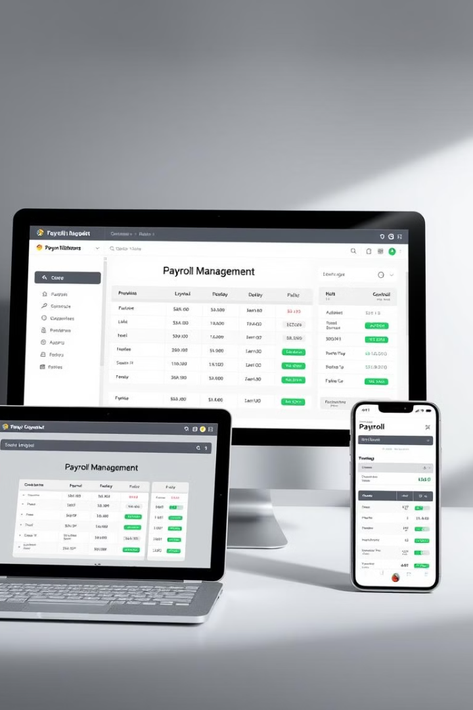


Responsive Design
Cross-Platform Compatibility
The frontend is designed to be responsive, adapting to different screen sizes and devices.
User Experience
Responsive design ensures a consistent and user-friendly experience across all devices, enhancing accessibility and usability.

Slide 11

Key Takeaways
This frontend development approach leverages Next.js for performance and scalability, Material UI for a visually appealing and user-friendly interface, and integrates seamlessly with a Spring Boot backend. The system provides a robust and efficient solution for payroll management, empowering administrators to generate payslips efficiently and securely.

